Slide 1

8th Grade Math: Pre-Algebra
Unit 10, Lesson 4 Is It a Function? Volume 2, pg. 135

Slide 2


Benchmark
MA.8.F.1.1
Given a set of ordered pairs, a table, a graph, or mapping diagram, determine whether the relationship is a function. Identify the domain and range of the relation.
volume 2, pg. 135

Slide 3
Integrated Mathematical Thinking and Reasoning Standards
MA.K12.MTR.1.1 Actively participate in effortful learning both individually and collectively.
MA.K12.MTR.2.1 Demonstrate understanding by representing problems in multiple ways.
MA.K12.MTR.4.1 Engage in discussions that reflect on the mathematical thinking of self and others.
volume 2, pg. 135

Slide 4

Learning Target
I can determine whether a relation is a function.
volume 2, pg. 135

Slide 5

Warm-Up
volume 2, pg. 135

Slide 6
10.4.1 Warm-Up: Sticking With It
Engineering students learn many lessons both in and out of the classroom. One student shared what she learned: “Sometimes there is a lot of pressure that can cause unwanted strain, but it is what happens at the point of failure that reveals the amount of strength that is really inside.”
What is one life lesson you have learned this school year?
When is a time when you have had to stick with something that was hard in order to reach a goal?
volume 2, pg. 135

Slide 7

Guided Practice
volume 2, pg. 136

Slide 8

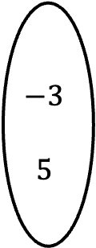



10.4.2 Guided Practice: Is It a Function?
A function is a mathematical relation for which each element in the domain corresponds to exactly one element in the range.
Two relations are shown below.
Relation A | Relation B
$$6$$
$$8$$
$$15$$
$$−3$$
$$5$$
$$6$$
$$8$$
$$15$$
$$−3$$
$$5$$
volume 2, pg. 136

Slide 9
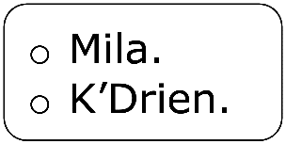
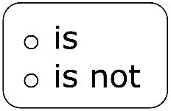
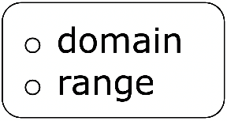
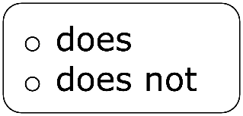
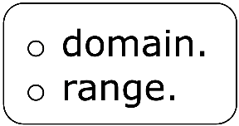
Mila said that neither Relation A nor Relation B is a function.
K’Drien said that Relation A is not a function, but reasoned that Relation B is a function.
Complete the statements.
I agree with I know that Relation B a function because each element in the correspond with exactly one element in the
volume 2, pg. 136

Slide 10
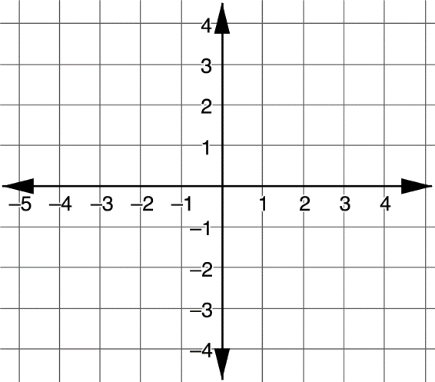
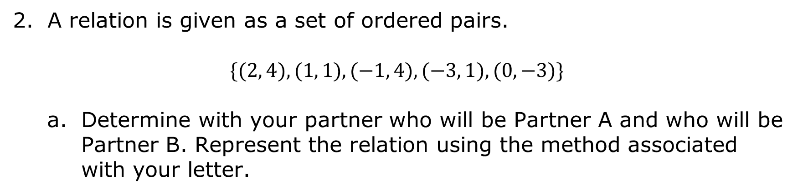
A relation is given as a set of ordered pairs.
$$\{(2, 4), (1, 1), (−1, 4), (−3, 1), (0, −3)\}$$
Determine with your partner who will be Partner A and who will be Partner B. Represent the relation using the method associated with your letter.
Mapping Diagram (Partner A) | Graph (Partner B)
volume 2, pg. 136

Slide 11
Check your partner’s representation. Once you both agree that each representation is correct, complete the other representation in your book.
volume 2, pg. 136

Slide 12
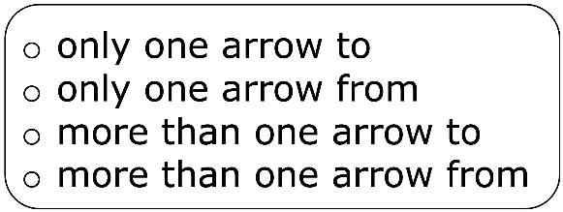
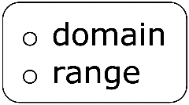
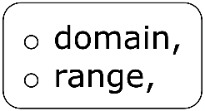
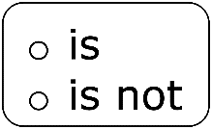
Complete the statements to explain how each representation shows whether the relation is a function.
The mapping diagram has each element in the to its corresponding element in the therefore the relation a function.
volume 2, pg. 137

Slide 13
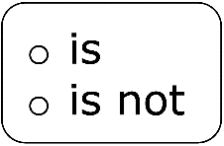
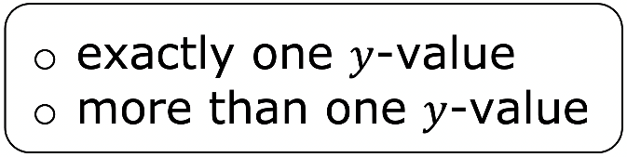
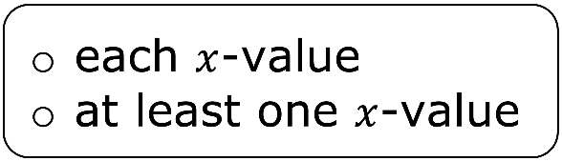
The graph demonstrates the relation a function because corresponds to on the graph.
volume 2, pg. 137

Slide 14
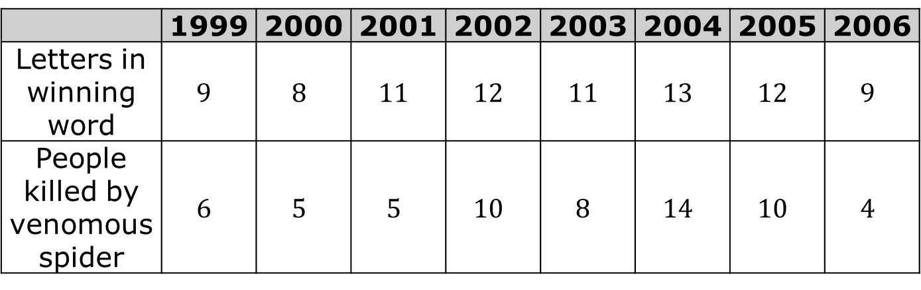
The table below gives the number of letters of the winning word of the Scripps National Spelling Bee, and the number of people killed by venomous spiders for the years 1996-2006 (CDC).
 | 1999 | 2000 | 2001 | 2002 | 2003 | 2004 | 2005 | 2006
Letters in winning word | $$9$$ | $$8$$ | $$11$$ | $$12$$ | $$11$$ | $$13$$ | $$12$$ | $$9$$
People killed by venomous spider | $$6$$ | $$5$$ | $$5$$ | $$10$$ | $$8$$ | $$14$$ | $$10$$ | $$4$$
volume 2, pg. 137

Slide 15
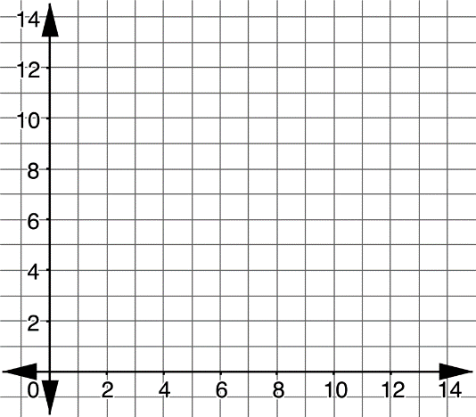
Using the same partner letters as in the previous problem, represent the relation with a mapping diagram and as a graph.
Graph (Partner A) | Mapping Diagram (Partner B)
Check your partner’s representation. Once you both agree that each representation is correct, then complete the other representation.
volume 2, pg. 137

Slide 16
Use the definition of a function to justify whether the relationship between the number of letters of the winning word of the Scripps National Spelling Bee and the number of people killed by venomous spiders is a function or not.
volume 2, pg. 138

Slide 17

Exploration
volume 2, pg. 138

Slide 18


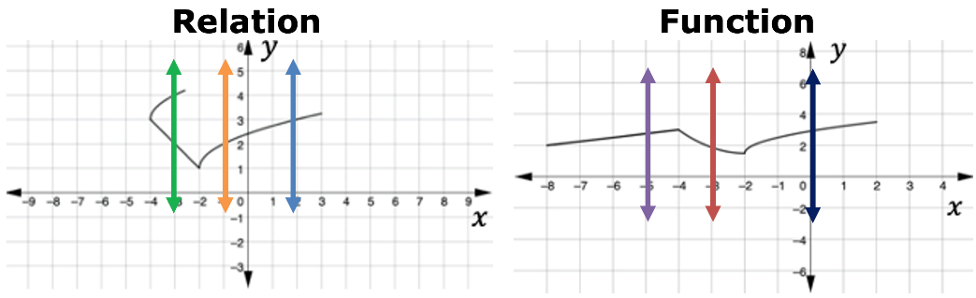
10.4.3 Exploration: Vertical Line Test
The vertical line test can be used to determine if a relation represented by a graph is a function.
The vertical lines drawn on the graph of a function show whether each 𝑥-value corresponds to exactly one 𝑦-value.
A graph of a relation and a function are shown with three different vertical lines drawn on each.
volume 2, pg. 138

Slide 19
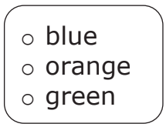
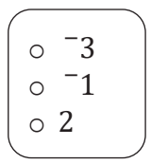
Complete the explanation that describes how the vertical line test can be used to show the relation represented by a graph is not a function.
The line shows that the relation is not a function because the line demonstrates that for the 𝑥-value of there is more than one 𝑦-value.
volume 2, pg. 138

Slide 20
Sort the relations into each category by writing the letters that label the relations in the table.
Functions | Not Functions
volume 2, pg. 139

Slide 21
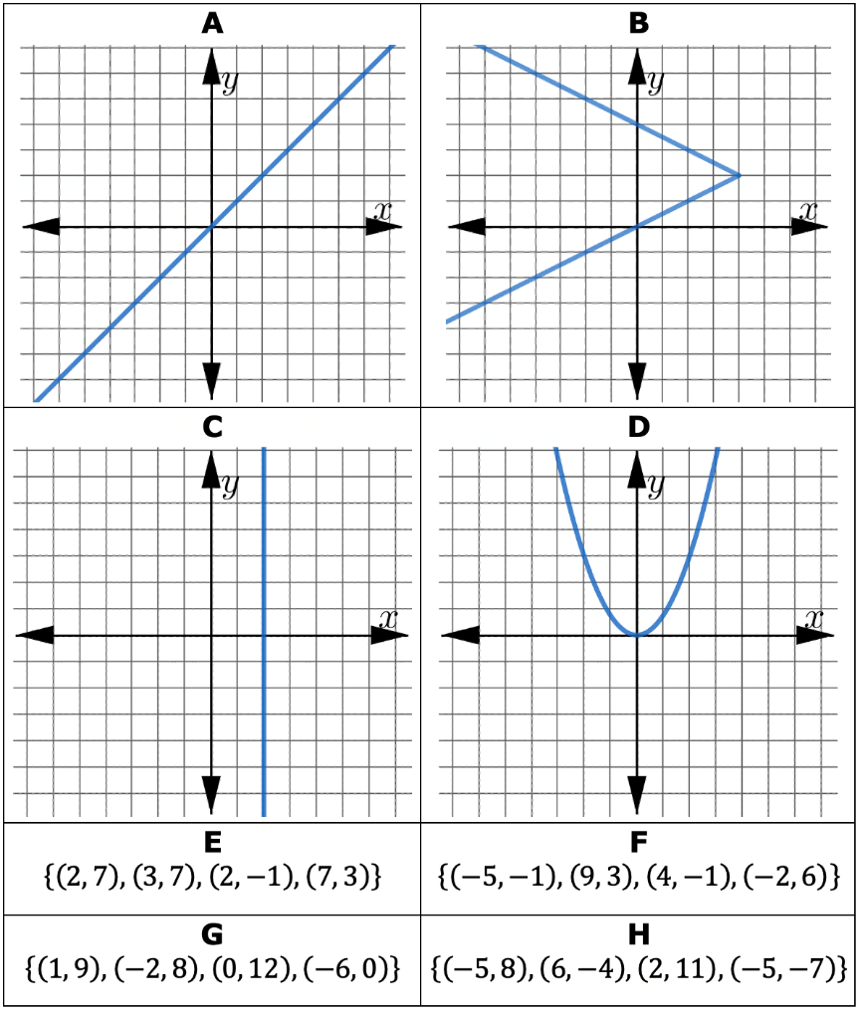
volume 2, pg. 139

Slide 22

Your Turn
volume 2, pg. 139

Slide 23
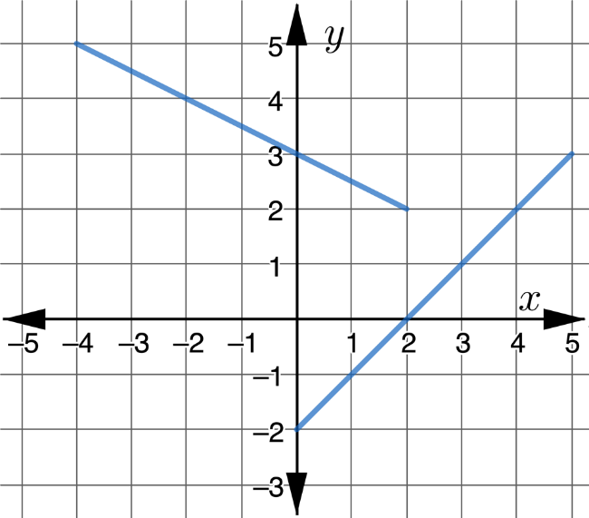
10.4.4 Your Turn!
A group of students were discussing whether the relationship on the graph is a function.
volume 2, pg. 139

Slide 24
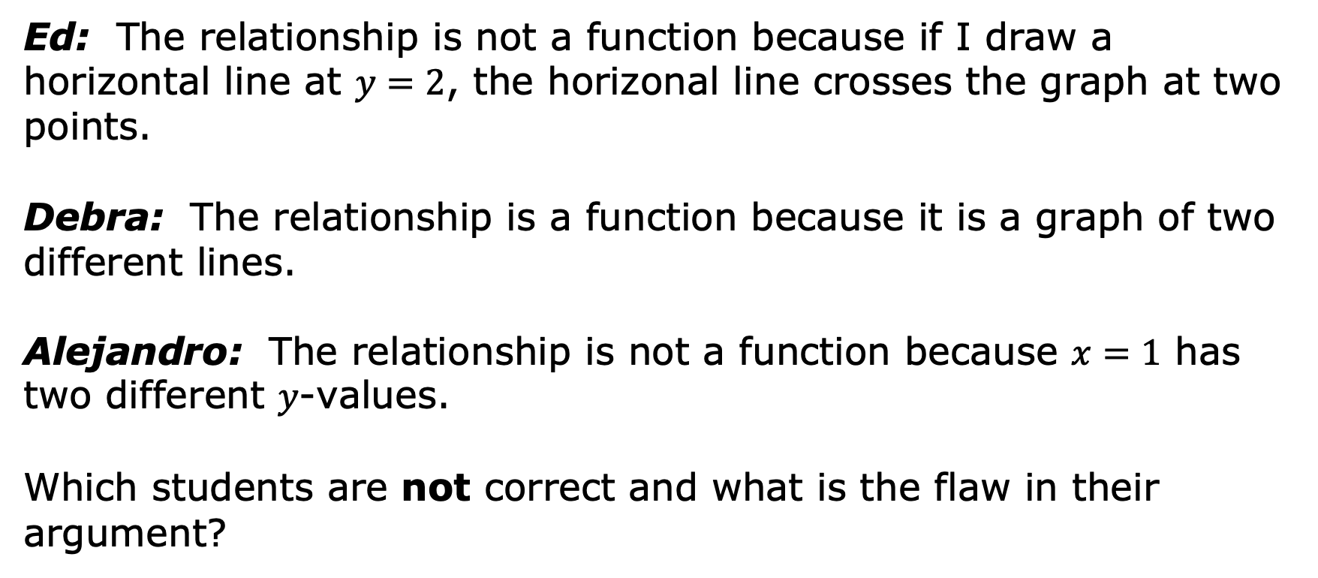
Ed: The relationship is not a function because if I draw a horizontal line at $y=2$, the horizonal line crosses the graph at two points.
Debra: The relationship is a function because it is a graph of two different lines.
Alejandro: The relationship is not a function because $x=1$ has two different 𝑦-values.
Which students are not correct and what is the flaw in their argument?
volume 2, pg. 139

Slide 25
Consider the following incomplete mapping diagrams.
Diagram A Diagram B Diagram C
3
2
-1
5
5
5
3
2
-1
5
5
5
5
5
5
3
2
-1
Complete Diagram A so that it is a function.
Is it possible to complete Diagram B so that it is not a function? If so, complete the diagram to show a relation, but not a function. If not, justify your reasoning.
volume 2, pg. 140

Slide 26
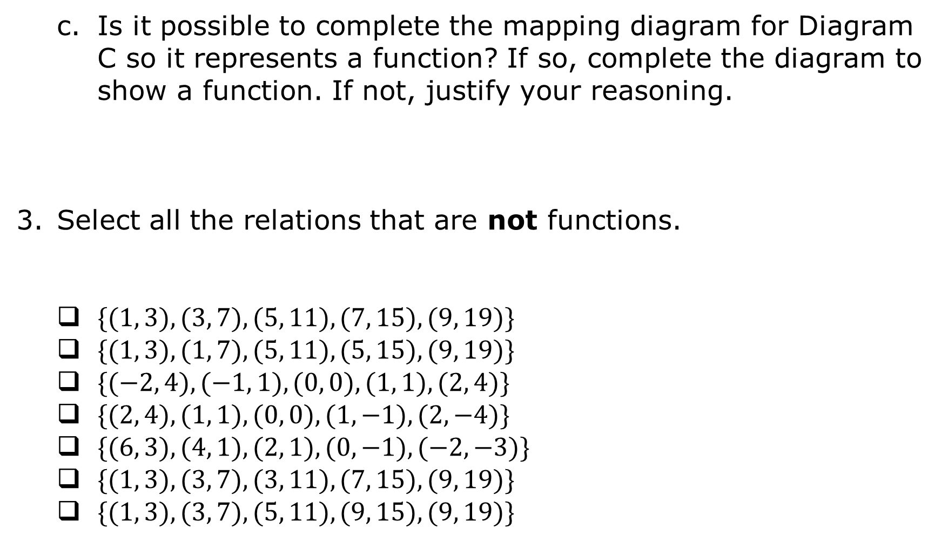
Is it possible to complete the mapping diagram for Diagram C so it represents a function? If so, complete the diagram to show a function. If not, justify your reasoning.
Select all the relations that are not functions.
$\{(1, 3), (3, 7), (5, 11), (7, 15), (9, 19)\}$
$\{(1, 3), (1, 7), (5, 11), (5, 15), (9, 19)\}$
$\{(−2, 4), (−1, 1), (0, 0), (1, 1), (2, 4)\}$
$\{(2, 4), (1, 1), (0, 0), (1, −1), (2, −4)\}$
$\{(6, 3), (4, 1), (2, 1), (0, −1), (−2, −3)\}$
$\{(1, 3), (3, 7), (3, 11), (7, 15), (9, 19)\}$
$\{(1, 3), (3, 7), (5, 11), (9, 15), (9, 19)\}$
volume 2, pg. 140

Slide 27

Wrap-Up
volume 2, pg. 140

Slide 28
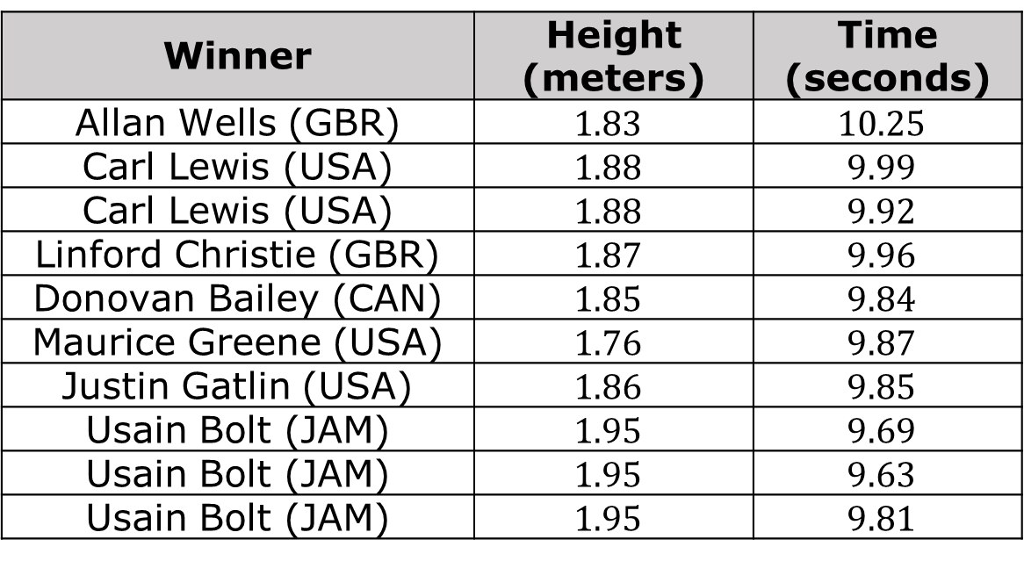
10.4.5 Wrap-Up: Error Analysis
The table shows the gold-medal winners of the $100$-meter dash in the Olympic games since 1980.
Winner | Height (meters) | Time (seconds)
Allan Wells (GBR) | $$1.83$$ | $$10.25$$
Carl Lewis (USA) | $$1.88$$ | $$9.99$$
Carl Lewis (USA) | $$1.88$$ | $$9.92$$
Linford Christie (GBR) | $$1.87$$ | $$9.96$$
Donovan Bailey (CAN) | $$1.85$$ | $$9.84$$
Maurice Greene (USA) | $$1.76$$ | $$9.87$$
Justin Gatlin (USA) | $$1.86$$ | $$9.85$$
Usain Bolt (JAM) | $$1.95$$ | $$9.69$$
Usain Bolt (JAM) | $$1.95$$ | $$9.63$$
Usain Bolt (JAM) | $$1.95$$ | $$9.81$$
volume 2, pg. 140

Slide 29
Both Olivia and Liam wrote an explanation about whether the table of values represents a function.
Olivia’s Explanation | Liam’s Explanation
The table of values of the gold-medal winners is a function because the winners competed in different years. | The table of values of the gold-medal winners is a function. Although there are some inputs that give different outputs, those inputs are for the same person.
volume 2, pg. 140

Slide 30
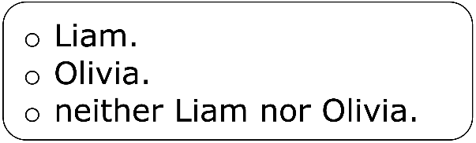
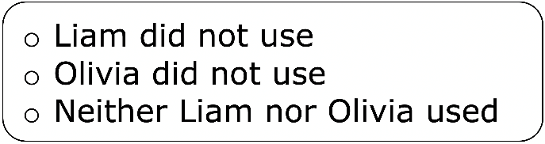
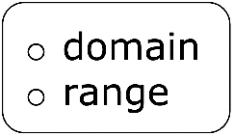
Complete the statements to evaluate both explanations.
I agree with the correct to determine if the relation in the table is a function.
volume 2, pg. 140

